Slide 1
How to incentivize people?
—reward mechanisms in multi-level marketing
Xiangyu Chen
Yiding Tao

Slide 2
Time Critical Social Mobilization. Pickard et al. Science 2011
Mechanisms for Multi Level Marketing. Emek et al. EC 2011.
Ethical Issues Connected with Multi-Level Marketing Schemes. Koehn. Journal of Business Ethics 2001.
Notes:
Today, we will mainly talk about three articles.
First one, second one, third one.
I will introduce … and my teammate yiding tao will introduce …

Slide 3
Paper 1: Time Critical Social Mobilization
Notes:
let's get to the point.
Require reading…

Slide 4
Task
It is a Network Challenge launched by DARPA
Goal:
Required teams to provide coordinates of ten red weather balloons placed at different locations in the continental United States.
Key point:
1) spread information about the tasks widely and quickly
2) effectively incentivize individuals to act
Notes:
First, it is a network Challenge launched by DARPA.
The goal of it … in a short time, maybe several days.
the problem as impossible by conventional information gathering methods
With the development communication technologies, and the Web and social media, Now we can solve this problem with the power of a large number of people
The key point is :

Slide 5

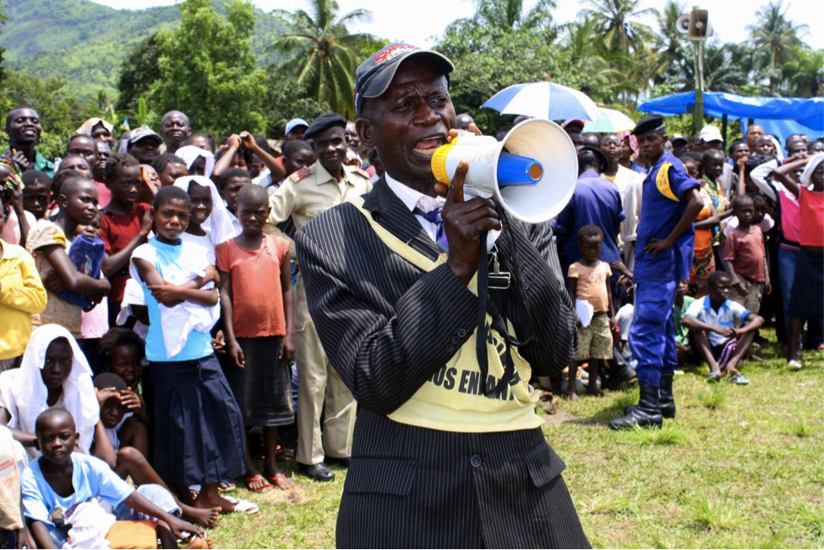

What we used to do?
POSTERS
LOUDSPEAKER
MASS MEDIA
Notes:
Before, let us think about what we used to do in past.
We may put up wanted posters.This is especially common when police arrest criminals.
We may also hold large gatherings. The host will then use a loudspeaker to tell everyone the information they want to spread.
Recently, after the rise of the Internet, mass media has become another way.
But, their shortcomes are obvious.
They cannot spread the info quickly and widely. Especially …
Cannot incentivize people well. Only the last people can get rewards, no motivation for a large amount of people to get involved into it.

Slide 6
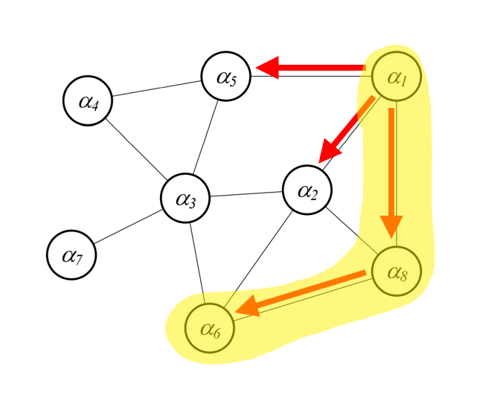
What we can do? —The Recursive Incentive Mechanism
Spread Chain:
α1 is the origin
agent α1 recruits α2, α5 and α8
α8 recruits α6
α6 finds balloon
Example social network.
Notes:
So, what we can do? The article proposed a Recursive Incentive Mechanism
The picture is a visualization of social network.
…

Slide 7
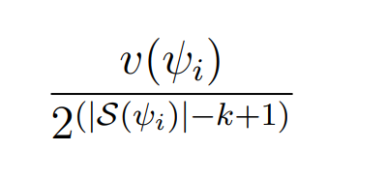
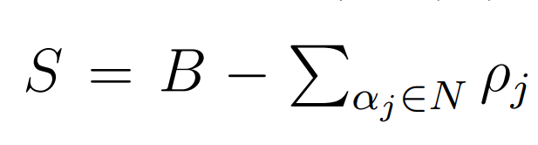
The Recursive Incentive Mechanism
Everyone on this chain will get a reward:
Budget for each task
Length of chain
Position on chain
Also, there is a surplus:
Notes:
Since we already have a spread chain, the next step is to reward all the people on the chain.
everyone on the success chian will get paid, the the amount is represented by this equation.
V refers to …
S refers to the chain, the absolute value notation refers to the length
K refers to …
I put the equations here to formally explain the solution. However, to understand it, we can avoid math.

Slide 8
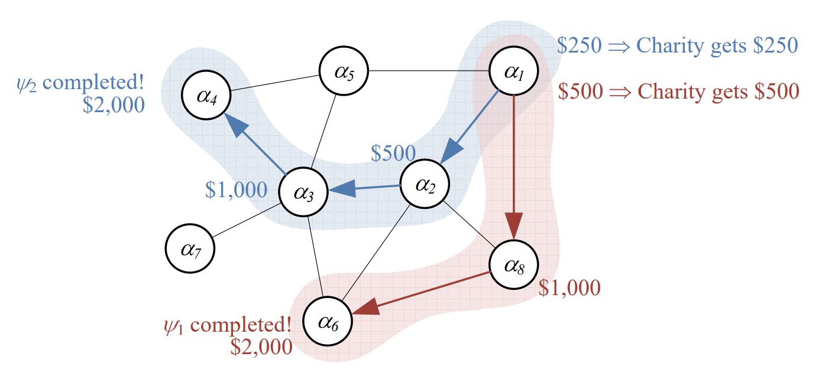
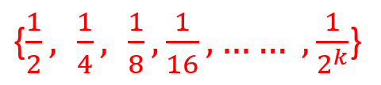
Let’s avoid math – An example
v(ψi) = 4000
Budget for finding a balloon is 4000
Split 4000 to all people on the success chain
surplus =
Notes:
Let’s look at an example.
Before, notice that v is 4000, which means ….
Suppose that we have two successful chains here. No matter how long the chain is, the last one will get half of the money. A6 and a4 get …
From back of the chain to beginning, everyone gets half amount of money， compared with the person behind him. A3,6 a2…
A1 shows in two chains, so a1 gets 750. This partly explains why people wants to recruits more people.

Slide 9
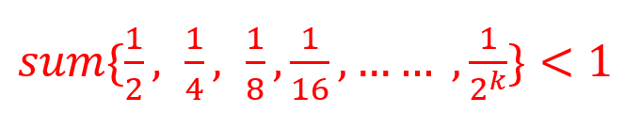
Analysis
“Recursive incentive mechanism is never in deficit”
Notes:
Quite straightforward

Slide 10
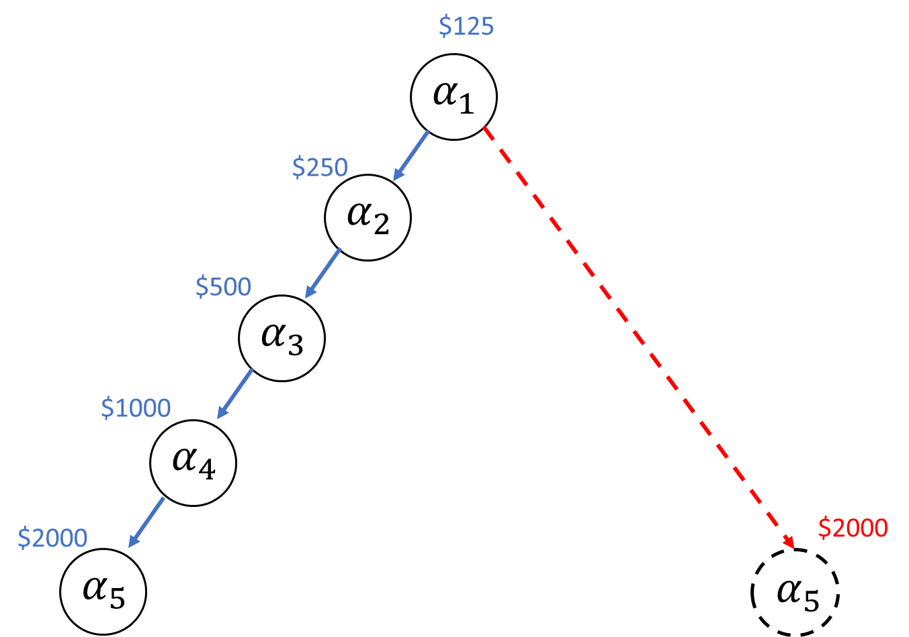
“Resistant to certain kinds of manipulation”
Suppose that α5 find the balloon
α5 doesn't care where he is on the chain
Not depend on position
Not depend on length of chain
Notes:
Also, another good property of this Mechanism is that it can Resistant to certain kinds of manipulation
Consider the blue chain first. A5 finds the targets. What if he didn’t want to recruited by a4? maybe avoid click the link provide by a4, go to website?
It shows that it can Resistant this kinds of manipulation

Slide 11
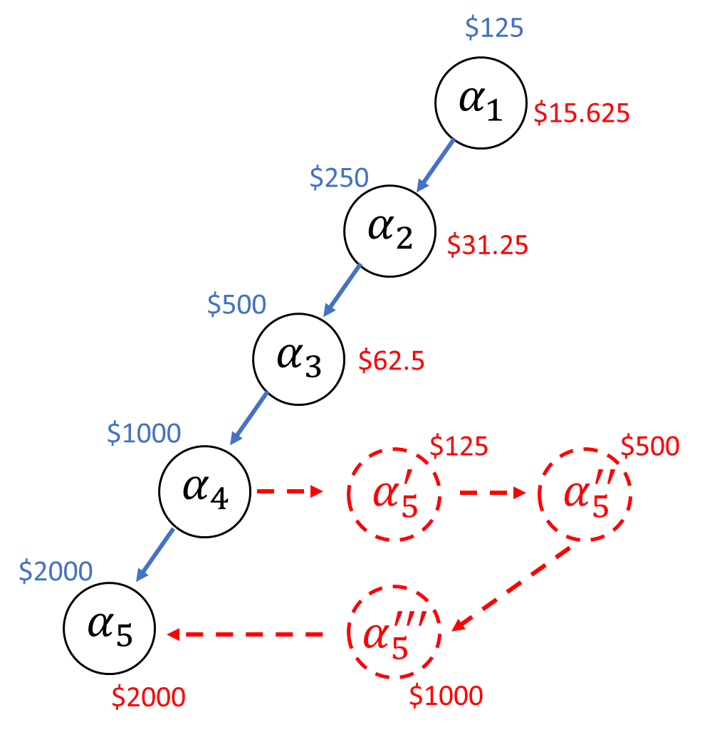
Discussion 1 – Fake Name Attack
Originally, α5 will get $2000
With fake name attack, α5 will get $3625,
or even more
Discuss for 3min:
What if someone creates lots of accounts and thus takes lots of nodes in the chain to get more money? Can you come up with some ideas against this?
Notes:
however , when facing another kind of attack, Fake Name Attack, we might be in some trouble.
Also, consider the blue chain first.
Instead of click a4’s link directly, he create three accounts first and recruit himself first. The red chain is a visualization.
…
Here is the first discussion part.

Slide 12
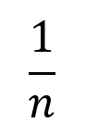
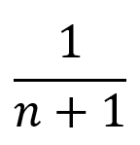
Why the Model Works
We want to make assumptions about limits and show that the model is optimal under both assumptions.
1）New members have no effect on existing members (about finding the target)
Why people recruits more nodes?
Recruiting more nodes does not affect the probability of finding target yourself
Recruiting more nodes increases the expectation of rewards
2）Each member’s probability decreases from to
Notes:
Next part, why …?
To prove this , first we made two assumptions , about the best and worst case. We want to prove that model is optimal under both assumptions.
Then, in any situation between best and worst, the model works, too.
First situation is that ……, maybe they are search completely different area.
so , we can think about why people wants to recruits more? 1. … 2. Even if i cannot find target, people recruited by me will have chance to find and i will also get paid, because i am on the chain.
Another case is that …., this is the worst situation.

Slide 13
2）Each member’s probability decreases from to
Discussion 2:
Why the Model Works under this assumption?
Hint:
You can answer anything that comes to mind. However, the article uses Nash equilibrium to prove.
— “strategy profile in which all individuals recruit all their friends is a Nash equilibrium”
Notes:
This is another discussion part.
3 min

Slide 14
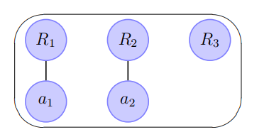
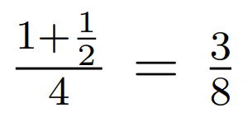
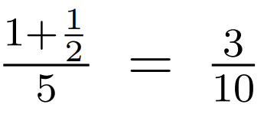
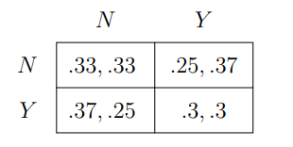
A simple scenario
neither of them recruits
Both receive ⅓
one recruits but the other does not
Recruiter:
Other: ¼
both recruit
Both receive
R3 always choose not to recruit
two players, R1 and R2
each of which has the option to recruit a single child or not
equivalent to the “prisoner’s dilemma.”

Slide 15
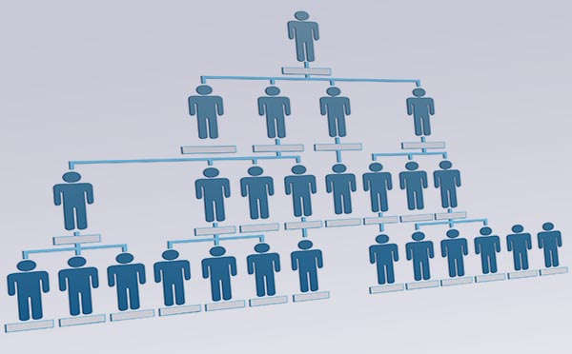
Discussion 3
Can you come up with one or more scenarios that the method used in the paper can be applied to?

Slide 16
Paper 2: Mechanisms for Multi Level Marketing

Slide 17

— Multi-level marketing is a marketing approach that motivates its participants to promote a certain product among their friends.

Slide 18
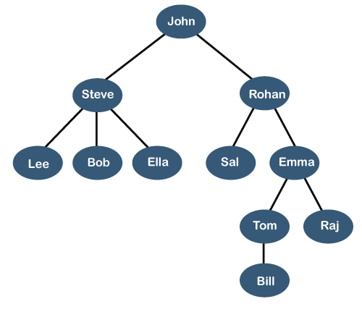
The referrals tree model
looking only at the structure of successful referrals
mark only a single referrer for introducing the product

Slide 19
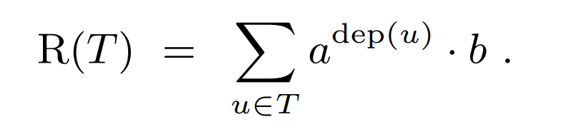
THE GEOMETRIC MECHANISM
– a reward mechanism
a & b: two constants that satisfied 0 < a < 1, b > 0
The referrals tree

Slide 20
Properties
Additivity (ADD)：
T1 and T2 merged by root, then R(T1 U T2) = R(T1) + R(T2)
Child Dependence (CD)：
The reward of the root is uniquely determined by the rewards of its children
Depth Level Dependence (DLD):
This property essentially means that the credit for a referral depends solely on how direct (or better said, indirect) this referral is.
Summing Contributions (SC):
SC implies that each node in the tree T contributes some independent amount to the root, and that amount depends only on its depth.
DLD and ADD <==> SC
a reward mechanism satisfied SC and CD <==> it is a geometric mechanism

Slide 22
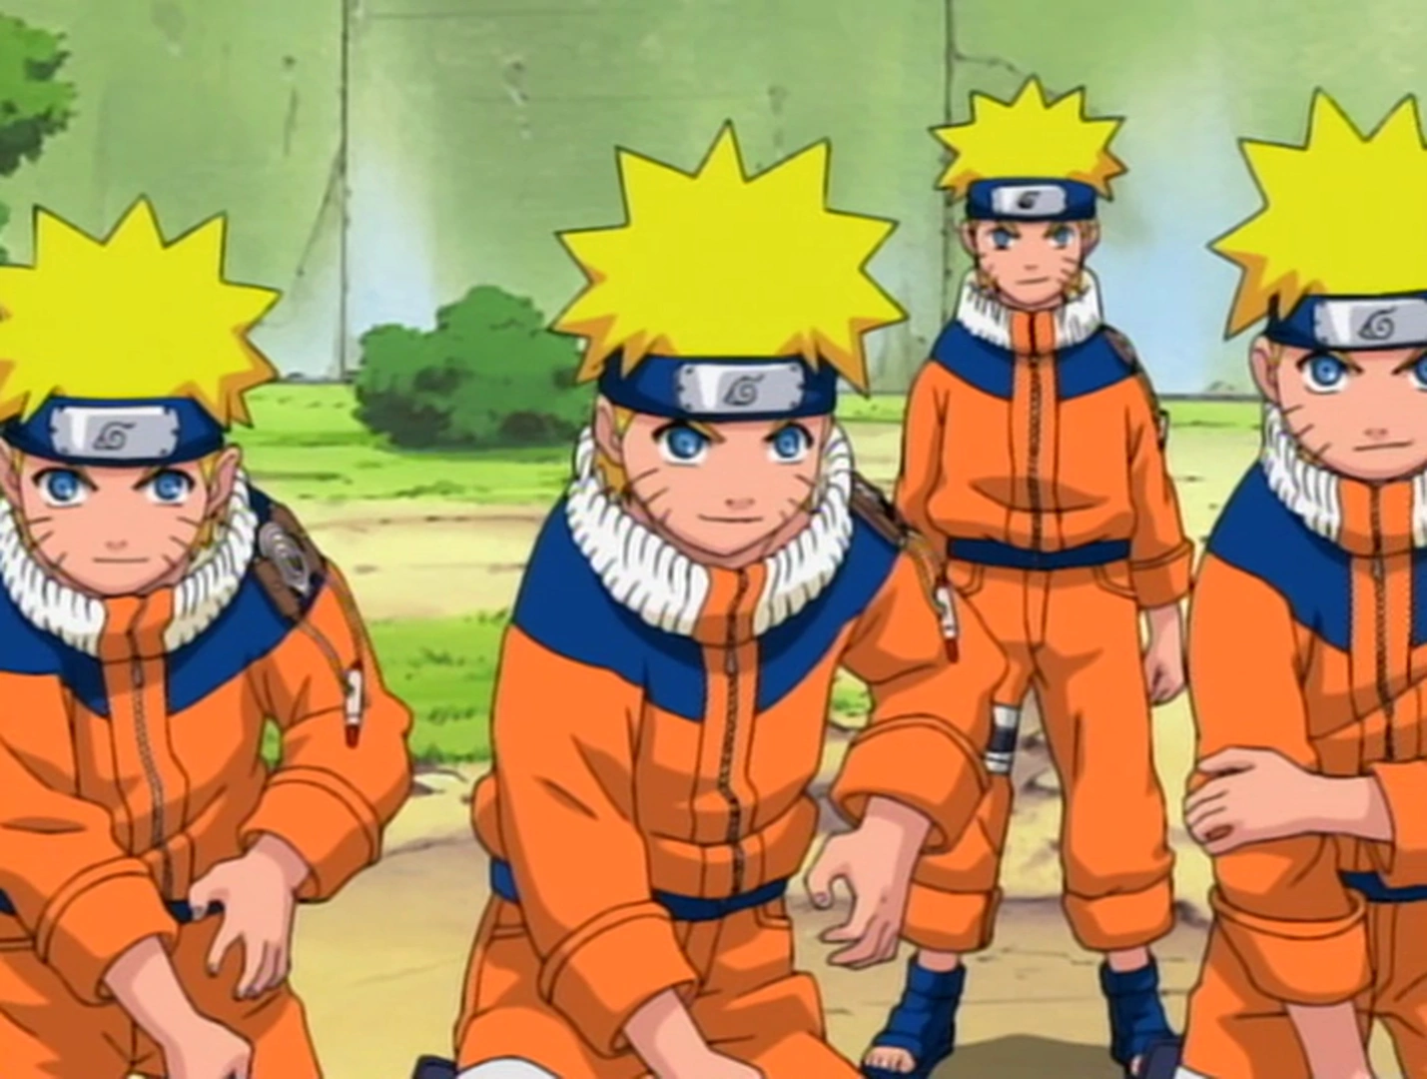
Sybil Attack
“An attacker subverts the service's reputation system by creating a large number of pseudonymous identities and uses them to gain a disproportionately large influence.”
Notes:
An attacker creates lots of fake identities to take up places which should be other real people. It is like ninja’s shadow clone.

Slide 23
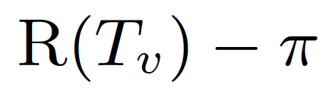
Without Sybil Attack
Profit =
Total amount of rewards earned
The money you pay for the product

Slide 24
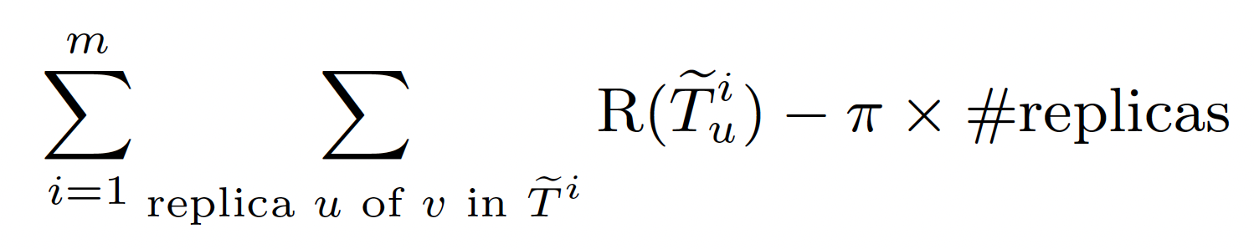
With Sybil Attack (Creating “replicas”)
New Profit =
Total amount of rewards earned
The money you pay for all the products
Based on this formula, how to prevent Sybil Attacks?
Notes:
Now the profit becomes the sum up of all the rewards you can get including from fake identities which is called replicas here, minus the the money you pay for all the products.
The designer could apply constraints on the calculation of rewards and set the price on product.
The premise here is people should pay a cost to join the game. In DARPA challenge, creating replicas does not cost extra money, so it is different.

Slide 25
About ethical issues on Multi-Level Marketing (MLM)
It can be legal
Refer a friend to get rewards/cashback
It can also be illegal!
Pyramid scheme / Endless-chain scheme

Slide 26
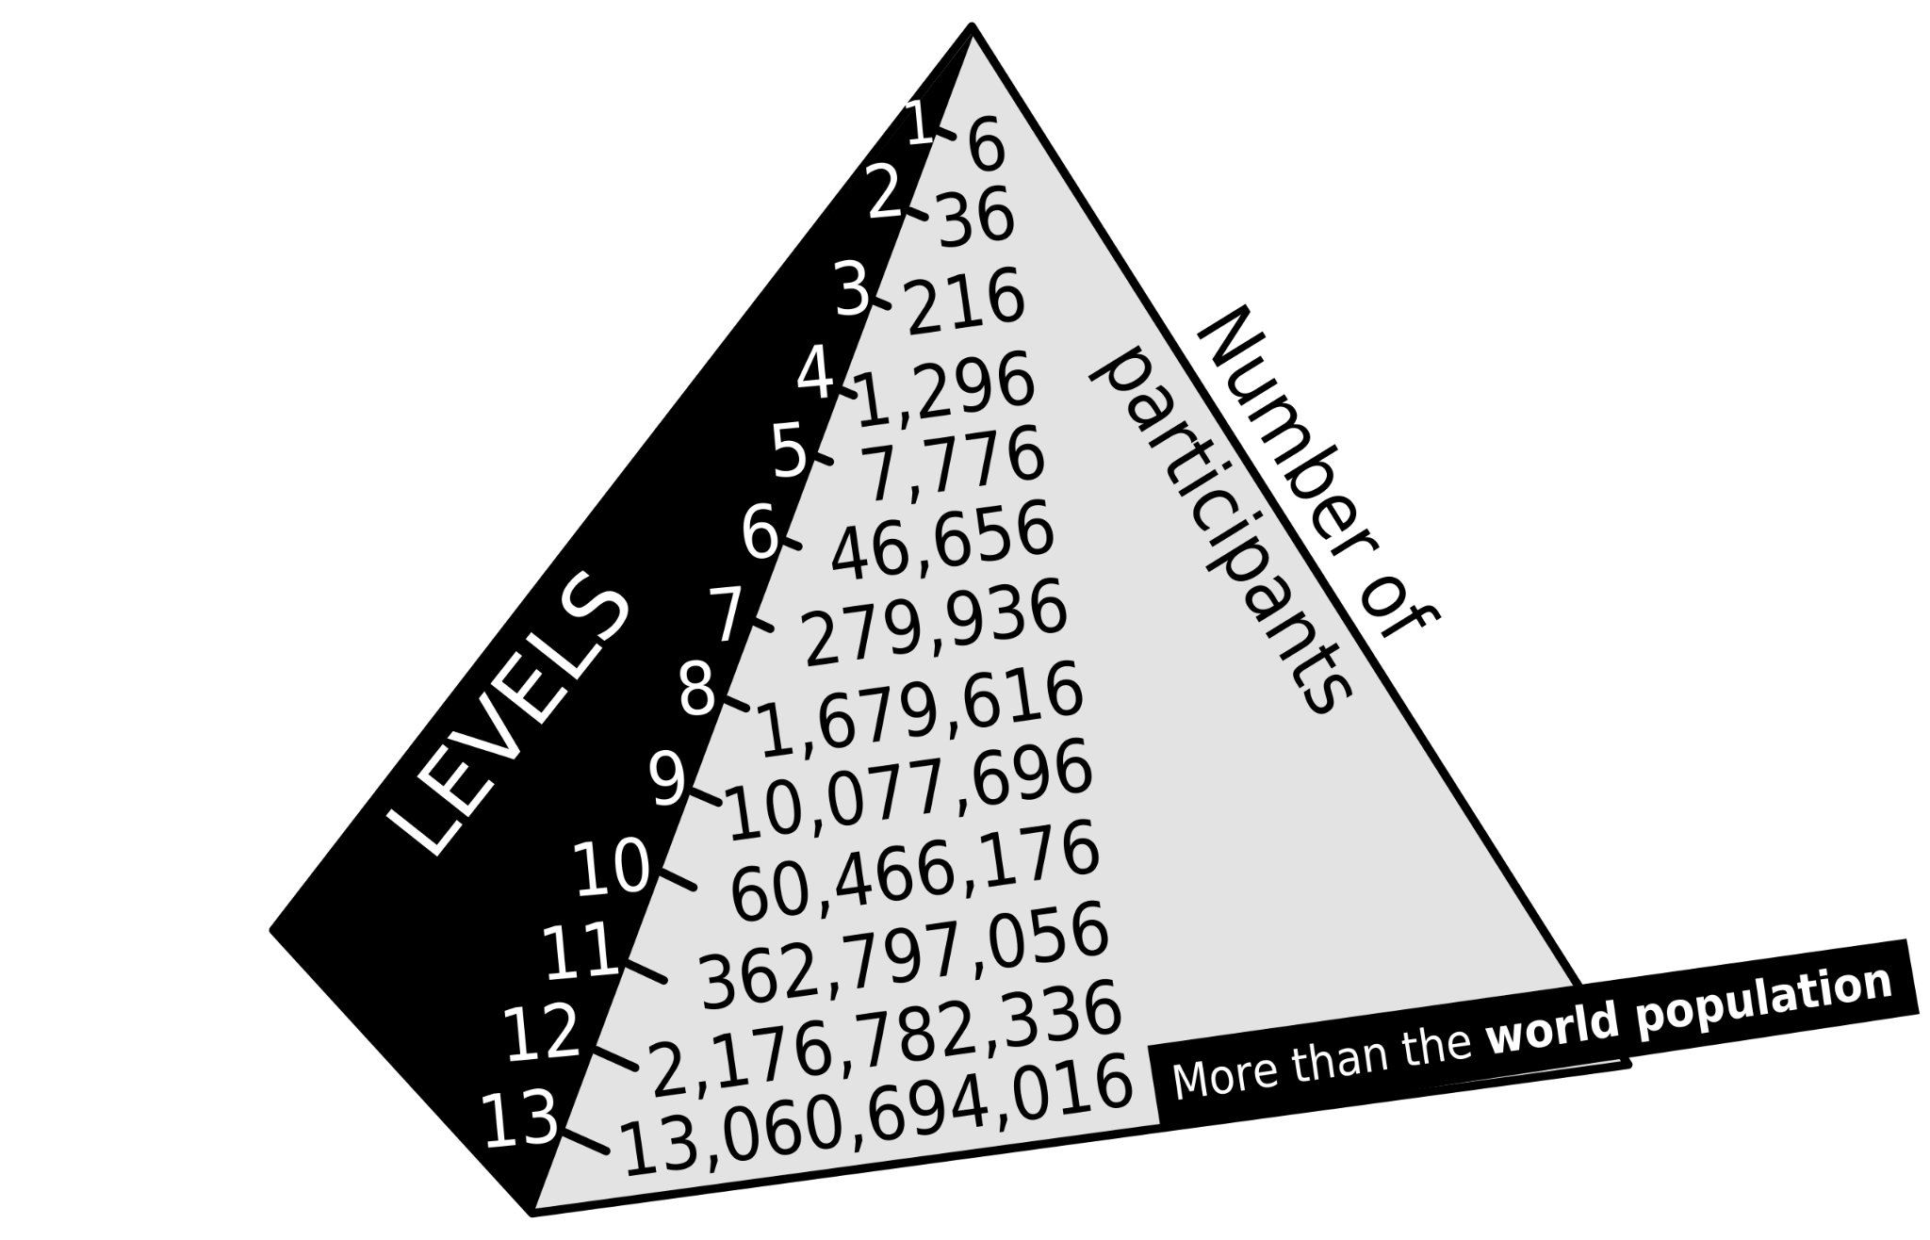
Pyramid Scheme
Notes:
Pyramid schemes ask people to make an investment and, in return, give them a license to recruit others who, in turn, recruit still others into the scheme. In essence, the investor pays for the opportunity to receive compensation when his or her recruit brings others into the scheme. So the product is the opportunity to recruit.
This is a picture of classic pyramid scheme in which every member is required to recruit six new people. The 2.2 billion people in the 12th layer would be required to recruit 13.1 billion more people for the 13th layer, to sustain the scheme, but this is larger than the population of the world.

Slide 27
Why Pyramid scheme is illegal?
It is fraudulent
Small investment -> Large return
Get something for nothing
It is recruitment-centered rather than product-centered
Notes:
Such schemes are illegal because they are unethical in two respects. They are (1) fraudulent, and they are (2) recruitment-, rather than product-, centered businesses. Pyramid schemes are fraudulent because they typically promise a large return in return for a small investment. Those who join a pyramid scheme early often do make a great deal of money. Those who come in later, however, make little or even lose money because there simply are not enough remaining people left to recruit into the network.

Slide 28
David Rhodes electronic chain letter
You, as the first participant, see a list of 10 people on a bulletin boards;
You send money to the person at the top of the list;
Then you remove the top person name and put your name at the button of the list;
Forward this list to 10 bulletin boards.
You may receive money once you reach position 5
Question:
How many people would need to be involved before a participant would receive any money?
Notes:
Chain letters contain a list of people. Upon receipt of a chain letter, the recipient is to send something (money, postcard, an email message) to the person at the top of the list. The recipient then removes the top person and puts his own name at the bottom of the list.
In the famous David Rhodes electronic chain letter, the list consisted of ten people. Recipients were told to send money to the person at the top of the list and to forward the letter to ten bulletin boards. Those who participated would receive money once they reached position 5 on the list (Watrous, posted as of 1999). But how many people would need to be involved before a participant would receive any money?

Slide 29
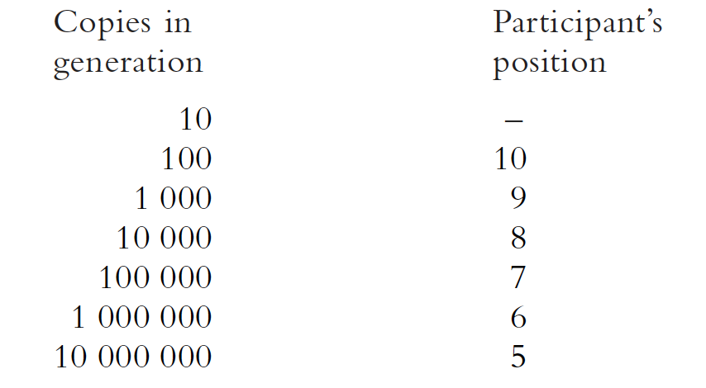
David Rhodes electronic chain letter
Notes:
As the schematic shows, the participant does not make any money until ten million electronic bulletin boards have been drawn into the scheme. There are not that many bulletin boards in existence!

Slide 30
Discussion 4
How to identify legal and ethical MLMs? Based on your previous knowledge and even experience.

Slide 31
How to identify legal and ethical MLMs?
In general:
Really sell something
Monitor performance of independent agents to ensure that they really are making retail sales.
Buy-back/Quit guarantee
Have buy-back policies in place so that independent contractors do not get stuck with excess product.
Low entry fee
Charge low upfront-fees for the right to market the MLM product.
Voluntary to buy sales training materials
Make purchases of sales training materials completely voluntary.

Slide 32
Really sell something
“Monitor performance of independent agents to ensure that they really are making retail sales.”
Sell things to end-consumers, not “sell to sales” or Self-consumption
In illegal MLM, the uplines in the company may pressure
downlines to buy more goods in order to reach a higher level
Notes:
So to be ethical,a MLM needs to do more than merely claim it has retail sales. It needs to monitor its sales buy requiring them to document sales to each end-user.

Slide 33
2. Buy-back/Quit guarantee
“Have buy-back policies in place so that independent contractors do not get stuck with excess product.”
If distributors must persuade their uplines to buyback the inventory, or if the upline is allowed to set the return price, distributors remain at risk.
(1) publish clear guidelines for return
(2) not play games designed to discourage inventory return
Notes:
Should set a reasonable buy-back price, like 90% of original price
It is important for MLMs to make it financially easy for distributors to leave the network precisely because participants in MLMs so often find it psychologically difficult to exit.
A illegal one may be like A says yes you can but you need to submit a return form, you can get this form from C
You are bounced from distributor to distributor

Slide 34
3&4 Upfront fees & sales materials
“Charge low upfront-fees for the right to market the MLM product and make purchases of sales training materials completely voluntary”
A company should not make most of money from upfronts fee or selling training materials to new recruits
The criteria should be carefully set
Notes:
A company should not make most of its money from upfronts fee, or by selling training materials that new recruits are pressured to buy
If an individual is buying a franchise, then a fee in the thousands or even millions might be appropriate
But if you are just a new staff to a mlm company and you need to buy training kit, then in this case 100 dollars can be too much.
Also depends on many factors like the development level of the country and regions.

Slide 35
Bad effects of illegal MLMs
Can hurt family members and friends.
“Instrumentalize” relations
Can exploit the host-guest relationship
Hosts want to “feed” the guests’ need
Can exploit the professional-client relationship
Notes:
Some MLMs encourage participants to sell product to family members and friends and/ or to recruit them into the MLM.
MLMs can alter human relationships, encouraging people to instrumentalize relations rooted in love and affection.
When you invite some guests to your house, you think you should be polite and satisfy their need.
Since the host is naturally to being responsive, this situation easily can be exploited by the MLM participants.
For example, doctors have been selling vitamin and non-prescription health products offered by MLMs in their offices

Slide 36
Discussion 5
The paper states that “many of those drawn into MLM schemes are desperate for a job”. So for students who are currently seeking a job, what are signals that a job might be an illegal MLM one?

